Slide 1

Housing Spot-Market Pricing Model for SlumRock Partners, LLP
Interim Report
Friday, January 27, 2020

Slide 2
Purpose and Outline.
Purpose: Deliver pre-final review of Housing Spot-Market Pricing Model for SlumRock, LLP.
Outline:
Review of motivation and value proposition.
SlumRock’s concept of operations.
Model-performance technical summary.
Recommendations.

Slide 3
SlumRock provides its general partners with exposure to the residential real-estate rental market.
The late-2000’s provided high-net-worth investors with the opportunity to realize returns on residential real estate via unconventional means.^{1, 2}
Abundance of below-market-price properties (foreclosures).
Temporary loss of profitability for more-conventional asset classes.
Collapse of usual customer base.
Persistent weak demand among Millennials.
SlumRock believes Aims, IA is an attractive next opportunity.
University town with educated, above-average-earning workforce.
As-yet-untapped by other players in the market.
¹ R. Dezember, L. Kuzisto, “Meet your new landlord: Wall Street”, Wall Street Journal, July 21, 2017, https://www.wsj.com/articles/meet-your-new-landlord-wall-street-1500647417
² A. Semuels, “When Wall Street is your landlord”, The Atlantic, February 13, 2019, https://www.theatlantic.com/technology/archive/2019/02/single-family-landlords-wall-street/582394/.

Slide 4
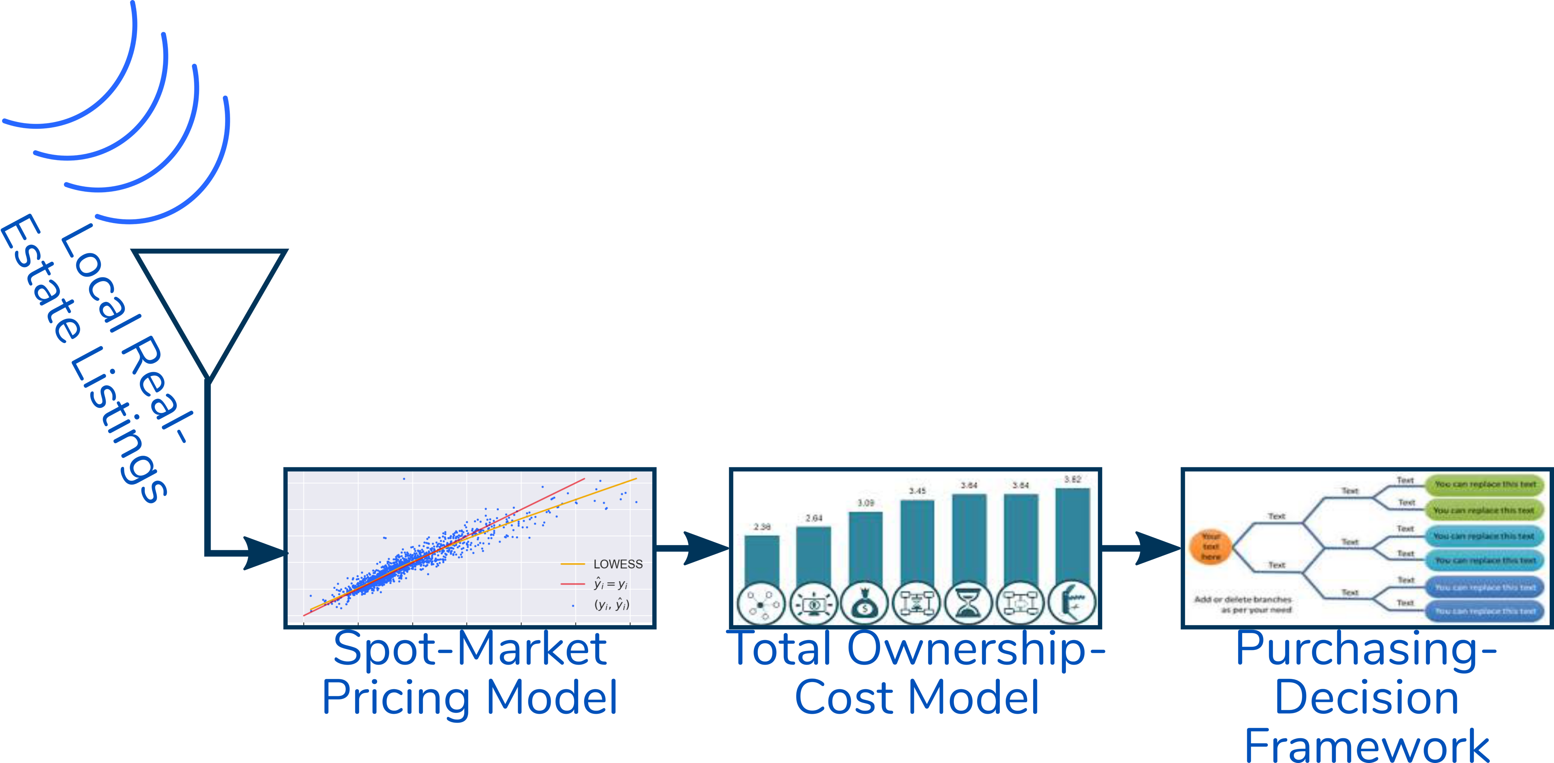
SlumRock’s spot-market pricing model is a key link in an agile fund-management framework.

Slide 5
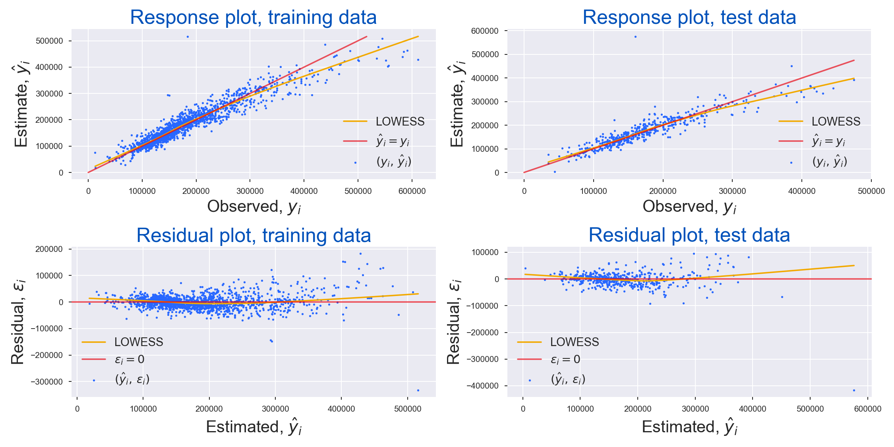
SlumRock’s spot-market pricing model explains most of the house-price variation except for a small number of outlier cases.
Edwards 2181
5100 ft²
$160^{k}
Edwards 1499
5650 ft²
$184^{k}
Edwards 2181
5100 ft²
$160^{k}
Edwards 1499
5650 ft²
$184^{k}

Slide 6
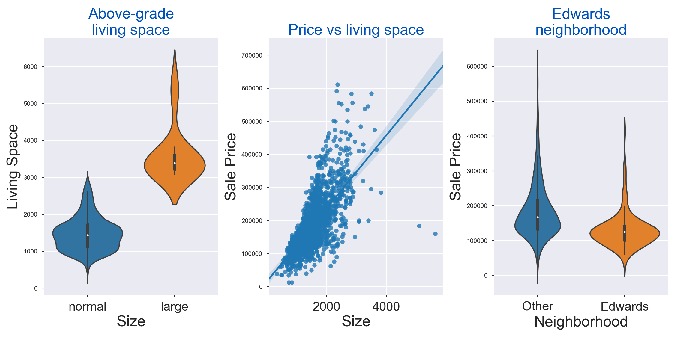
Large-footprint properties in the outlying, lower-cost Edwards neighborhood provide the most-egregious outliers.
Edwards 2181
5100 ft²
$160^{k}
Edwards 1499
5650 ft²
$184^{k}

Slide 7
Recommendations.
The performance SlumRock’s spot-marking pricing model is good enough to begin pilot buying activities.
SlumRock should explore more-sophisticated approaches to overcome the limitations of the present approach.

